Slide 1

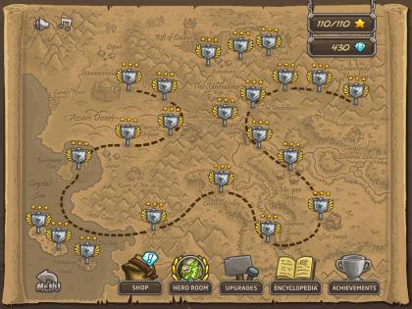
TITLE LEVEL
SELECT STAGE LEVEL

Slide 2
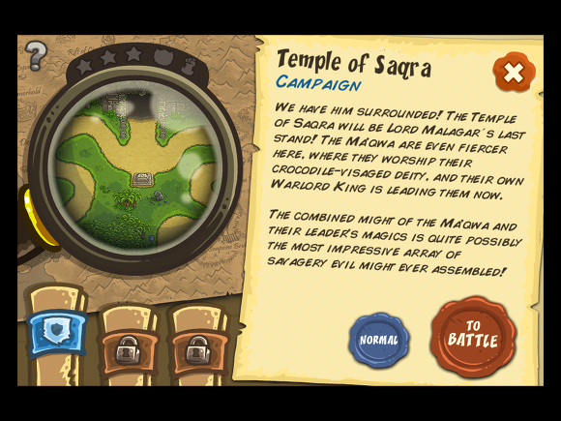

SELECT STAGE LEVEL
- Stage Explane
SELECT STAGE LEVEL
- Hero Room
리소스 부족으로 인해 영웅 구현 불가

Slide 3
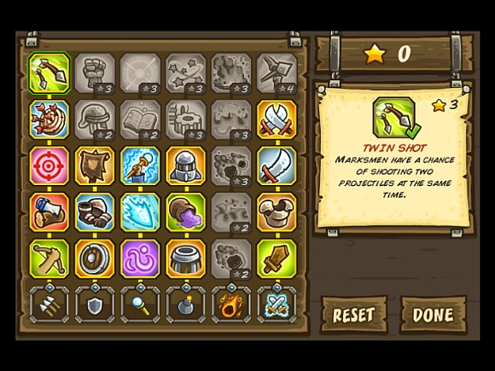
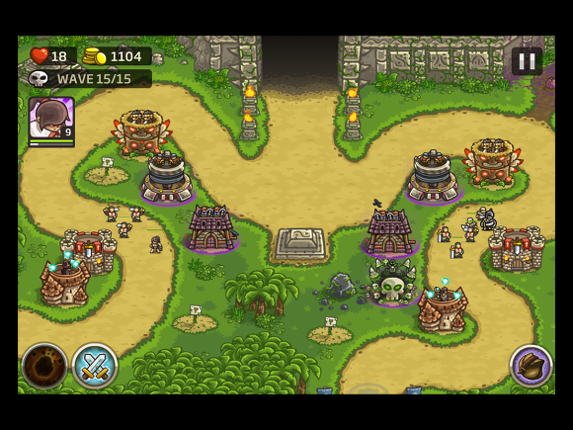
SELECT STAGE LEVEL
- Upgrade
PLAY STAGE LEVEL

Slide 4
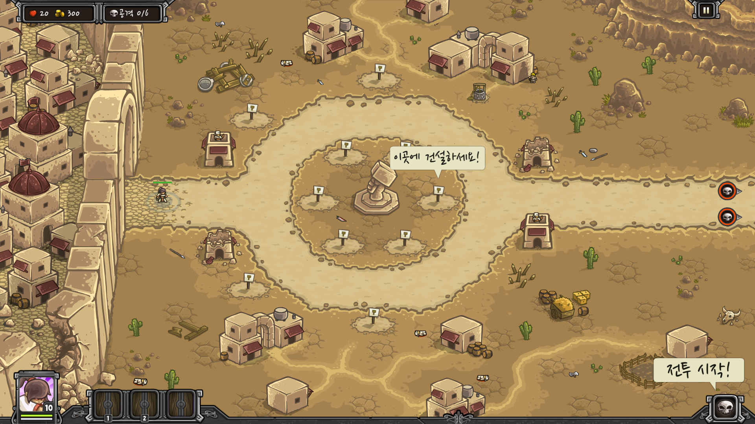
STAGE1
- Hammerhold
Wave | Enemies (North Path) |  | Enemies (South Path) |  | Income
0 | Desert Tung | 3 | Desert Tung | 3 | 30
1 | Desert Tung | 4 | Desert Tung | 4 | 40
2 | Desert Tung | 7 | Desert Tung | 7 | 70
3 | Desert Tung | 11 | Desert Tung Dune Raider | 2 2 | 97
4 | Dune Raider | 4 | Desert Tung | 14 | 134
5 | Desert Tung Dune Raider | 10 2 | Desert Tung Dune Raider | 10 2 | 164
초기 셋업
Gold. 300
1레벨 건물 4종 사용 가능
튜토리얼 생략
Wave Count. 6
NPC타워 1개

Slide 5
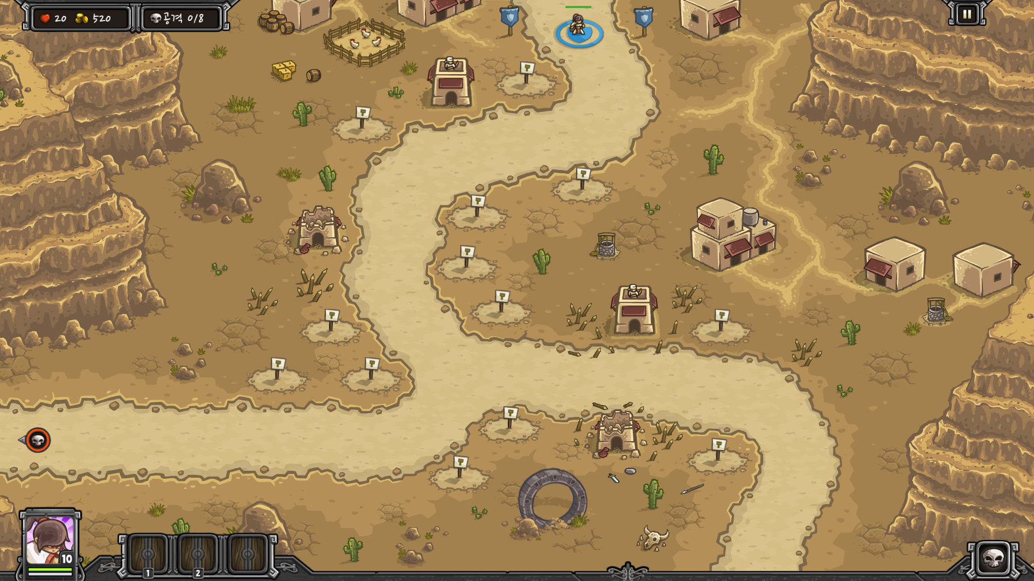
STAGE2
- Sandhawk Hamlet
Wave | Enemies (West) |  | Enemies (East) |  | Income
0 | Desert Tung | 20 |  |  | 100
1 |  |  | Desert Tung | 30 | 150
2 | Desert Tung Dune Raider | 8 8 | Desert Tung | 15 | 243
3 |  |  | Sand Hound | 38 | 190
4 | Desert Thug Dune Raider | 9 4 | Sand Hound | 20 | 209
5 | Desert Tung Dune Raider | 13 5 | Desert Tung Desert Raider | 13 5 | 290
6 | Sand Hound | 30 | Sand Hound | 30 | 300
7 | Sand Hound | 40 | Desert Thug Dune Raider | 10 10 | 410
초기 셋업
Gold. 520
2레벨 건물 4종 사용 가능
Wave Count. 8
NPC타워 2개

Slide 6
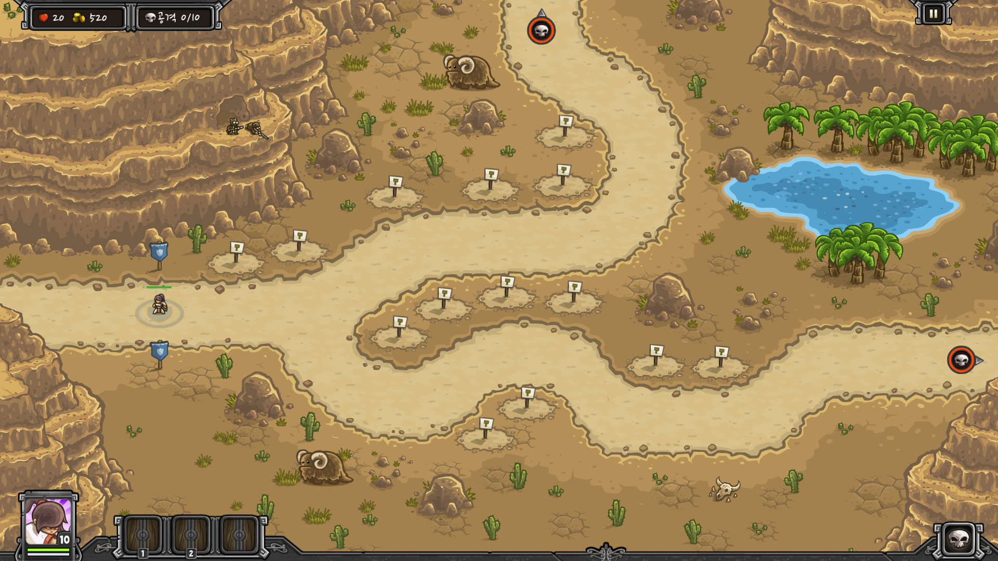
STAGE3
- Sape Oasis
Wave | Enemies (North) |  | Enemies (East) |  | Income
0 | Desert Tung | 10 | Desert Tung | 10 | 100
1 |  |  | Sand Hound | 20 | 100
2 | Dune Raider Desert Tung | 4 12 | Sand Hound | 20 | 224
3 |  |  | War Hound Sand Hound | 8 24 | 200
4 | Dune Raider Desert Tung | 4 15 | War Hound | 12 | 259
5 | Immortal Desert Tung Dune Raider | 3 31 4 |  |  | 291
6 | Immortal Desert Tung | 6 5 | Dune Raider Desert Thug | 8 10 | 347
7 | Immortal Desert Tung | 6 20 | War Hound Dune Raider | 10 5 | 424
8 | Dune Raider | 16 | Sand Hound | 38 | 636
9 | Immortal Dune Raider | 7 10 | War Hound Sand Hound | 15 30 | 628
초기 셋업
Gold. 520
3레벨 건물 4종 사용 가능
Wave Count. 10
중립 저격수

Slide 7
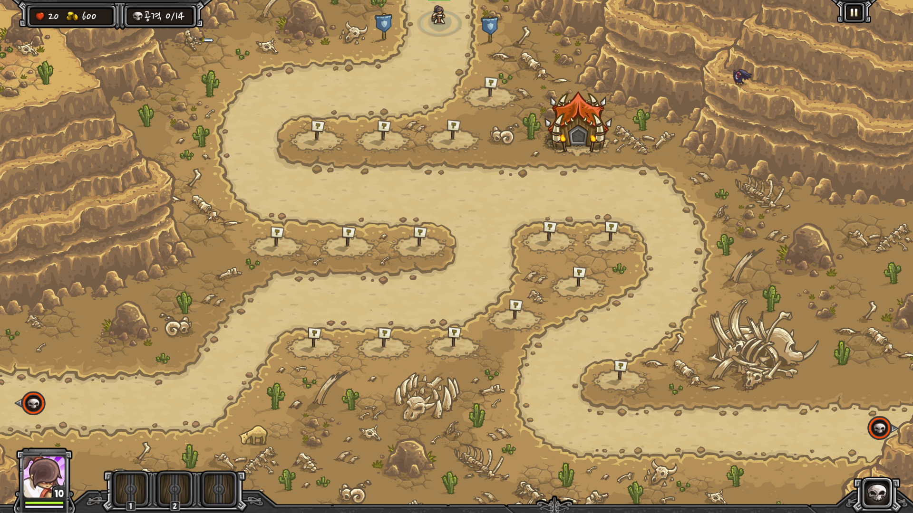
STAGE4
- Dunes of Despair
Wave | Enemies (West) |  | Enemies (East) |  | Income
0 | Desert Thug Dune Raider Sand Hound | 8 2 8 | Desert Thug | 10 | 162
1 | Desert Thug | 18 | Dune Raider Sand Hound | 3 12 | 198
2 | Desert Thug Dune Raider | 10 4 | Desert Thug Dune Raider | 10 4 | 228
3 |  |  | Dune Terror | 12 | 120
4 | Desert Thug Dune Raider Immortal | 18 10 3 |  |  | 322
5 | Giant Wasp | 10 | Giant Wasp | 10 | 160
6 | Dune Raider Desert Archer | 4 12 | Sand Hound War Hound | 12 6 | 328
7 | Desert Archer Immortal | 13 6 | Sand Hound War Hound | 28 6 | 500
8 | Giant Wasp | 18 | Dune Terror | 14 | 284
9 | Dune Raider Desert Archer | 14 16 | Dune Terror | 20 | 616
10 |  |  | Dune Terror Giant Scorpion | 20 5 | 340
11 | Dune Raider Immortal | 5 11 | Dune Terror Giant Scorpion | 20 5 | 684
12 | Giant Wasp | 30 | War Hound | 28 | 520
13 | Dune Raider Desert Archer Immortal | 10 14 8 | Dune Terror Giant Scorpion | 20 6 | 904
초기 셋업
Gold. 600
암살자 길드 건물
크로스 보우 건물 사용 가능
Wave Count. 14
중립건물 1(용병, 지니 소환)

Slide 8
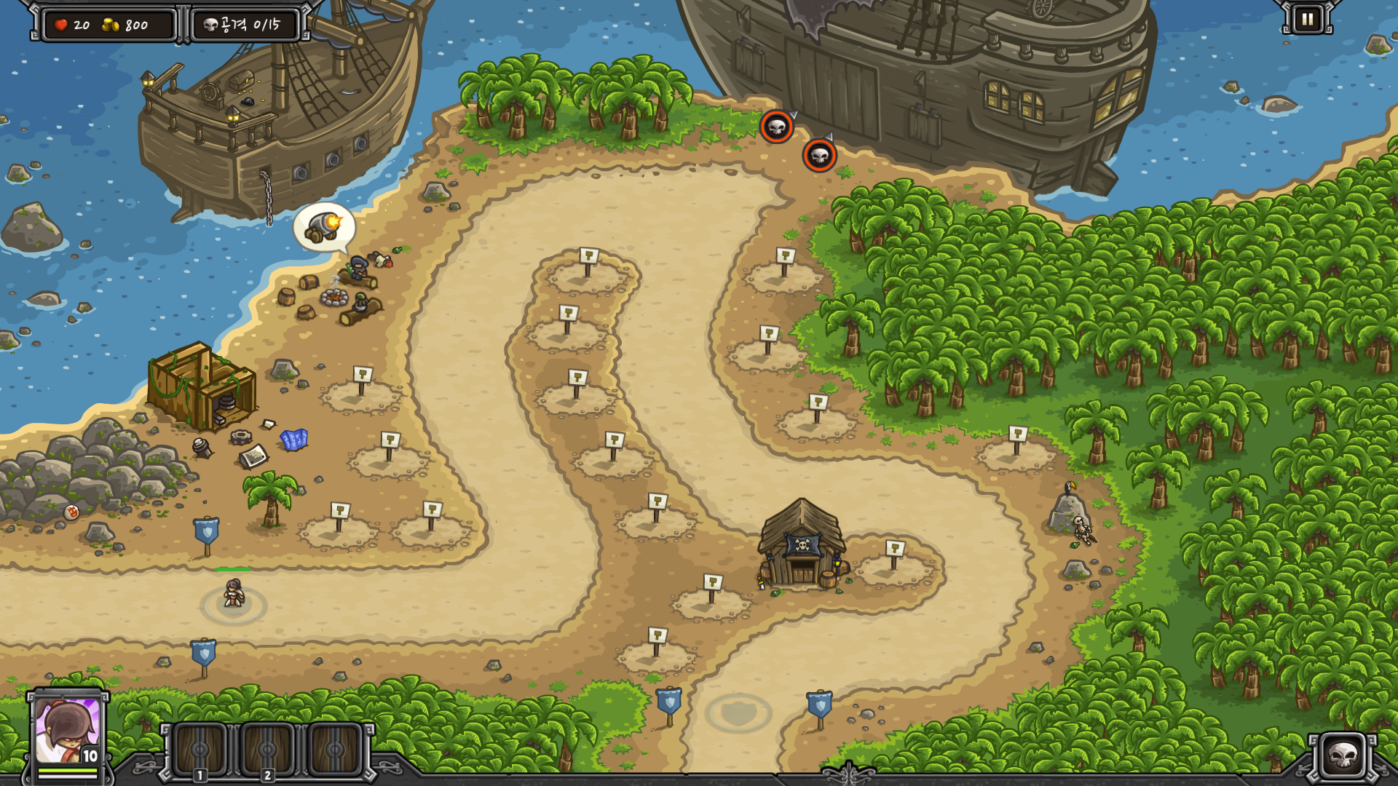
STAGE5
- Buccaneer’s Den
Wave | Enemies (West Path) |  | Enemies (East Path) |  | Enemies (East)
0 | Desert Thug | 23 | Dune Raider | 5
1 |  |  | Desert Thug Dune Raider | 28 6
2 | Sand Hound | 24 | Desert Thug Dune Raider | 15 6
3 | Desert Thug | 32 | Desert Thug | 32
4 | Desert Thug | 60 | Sand Wraith | 1
5 |  |  | Sand Hound War Hound | 34 30
6 | Dune Raider | 15 | Dune Raider | 15
7 | Desert Thug | 50 | Desert Thug | 50 | Executioner | 1
8 | Dune Raider Immortal | 6 5 | Dune Raider Immortal | 6 5 | Sand Hound War Hound | 18 13
9 | Sand Hound War Hound | 20 10 | Sand Hound War Hound | 20 10 | Dune Terror Giant Scorpion | 15 2
10 |  |  | Dune Raider Immortal | 28 12
11 | Dune Raider | 36 | Immortal Sand Wraith | 8 1
12 | Sand Hound War Hound | 48 7 | Sand Hound War Hound | 48 7 | Sand Hound War Hound | 36 4
13 | Immortal | 12 | Dune Raider | 15 | Giant Scorpion | 9
14 | Immortal | 18 | Dune Raider Executioner | 20 2 | Dune Terror | 30
초기 셋업
Gold. 800
드와프 건물 사용 가능
Wave8에 East 길이 생기는 이벤트 발생
Wave Count. 15
중립건물 1[해적 소환]
대포 구매 1

Slide 9
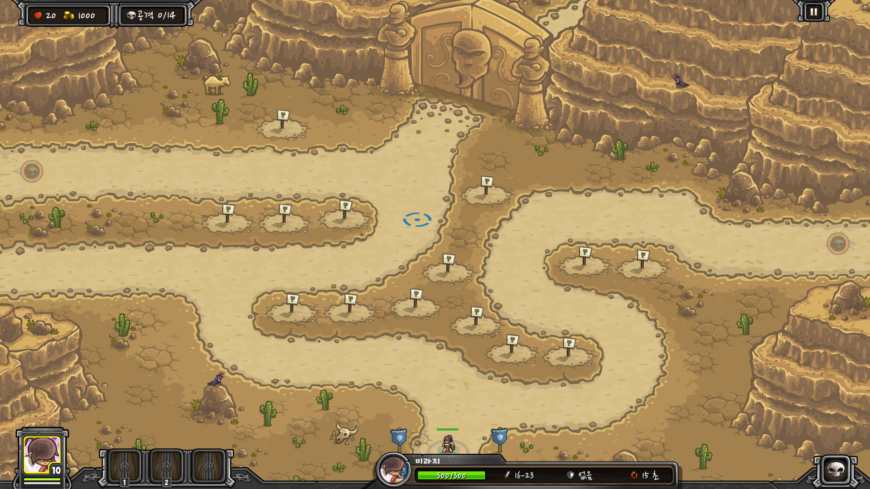
STAGE6
- Nazeru’s Gates
Wave | Enemies (North-West) |  | Enemies (West) |  | Enemies (East)
0 | Dune Raider | 10 |  |  | Desert Thug | 30
1 | Dune Raider | 10 | Sand Hound | 12 | Desert Thug | 26
2 | Dune Raider Immortal | 3 4 | Sand Hound | 30 | Desert Thug | 30
3 | Giant Wasp Wasp Queen | 10 1 |  |  | Giant Wasp | 15
4 | Immortal | 8 | Sand Hound War Hound | 10 10 | Sand Hound War Hound | 10 10
5 | Immortal | 12 | War Hound | 12 | Sand Wraith | 2
6 | Giant Wasp Wasp Queen | 30 1 |  |  | Dune Terror | 24
7 | Dune Raider Desert Archer | 16 10 |  |  | Dune Terror Giant Scorpion | 22 2
8 | Immortal Desert Archer | 11 10 | Giant Scorpion | 4 | Dune Terror Giant Scorpion | 17 3
9 | Immortal Desert Archer Executioner | 5 5 1 | Dune Raider Executioner | 8 1 | Dune Raider Desert Archer Executioner | 8 6 1
10 | War Hound | 25 | War Hound | 25 | War Hound | 30
11 | Desert Archer | 18 | Immortal | 12 | Dune Raider | 30
12 | Sand Wraith | 2 | Immortal | 20 | Sand Wraith | 2
13 | Immortal Executioner | 2 2 | War Hound Desert Archer | 30 15 | Sand Wraith | 4
초기 셋업
Gold. 1000
아크메이지 건물 사용 가능
Wave Count. 14
웨이브 종료 시 Boss
Nazeru

Slide 10
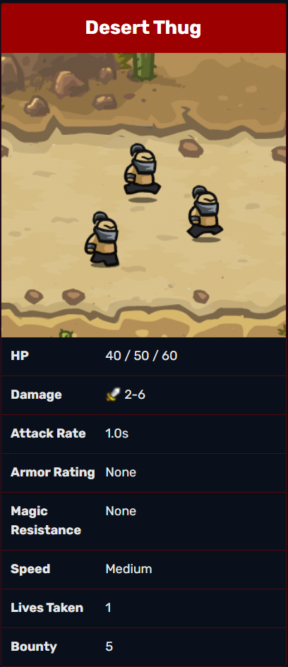
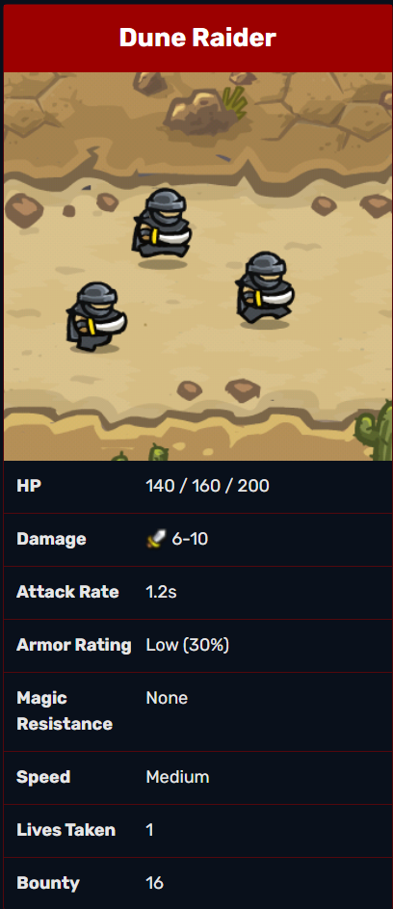
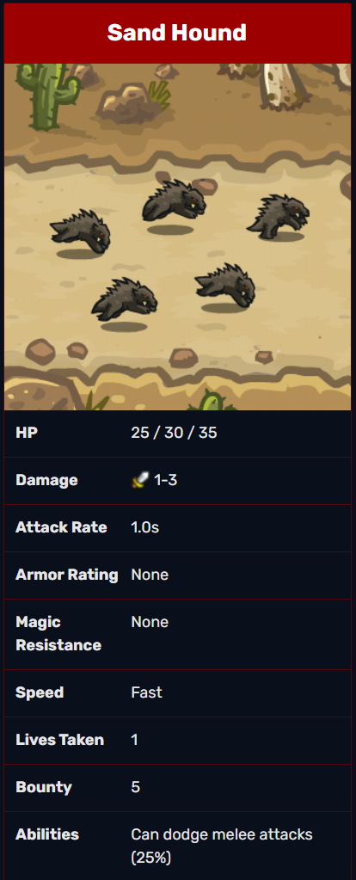
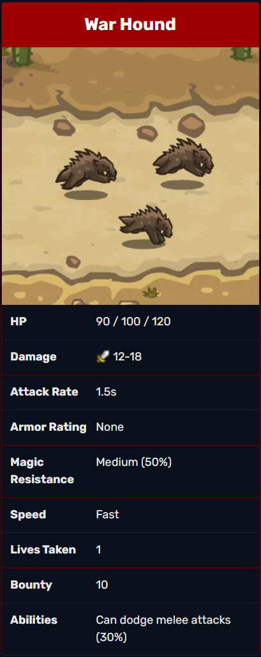

Slide 11
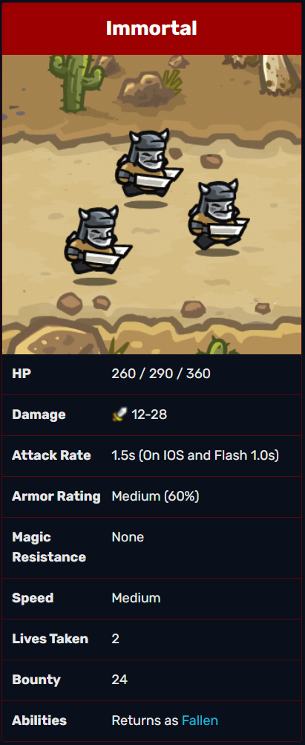
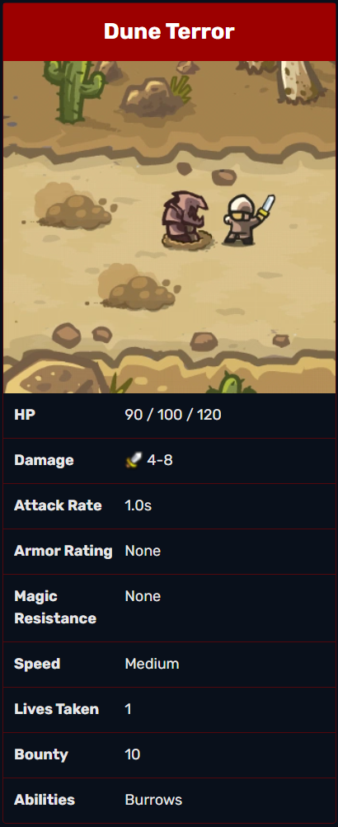
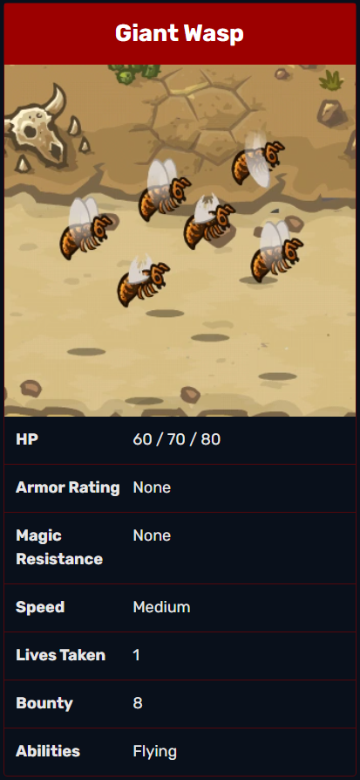
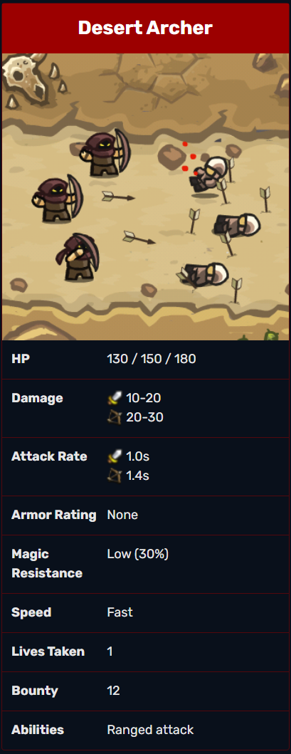

Slide 12
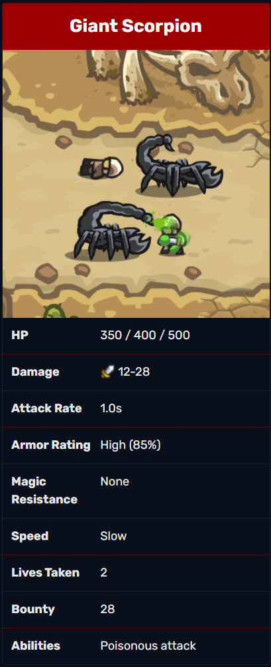
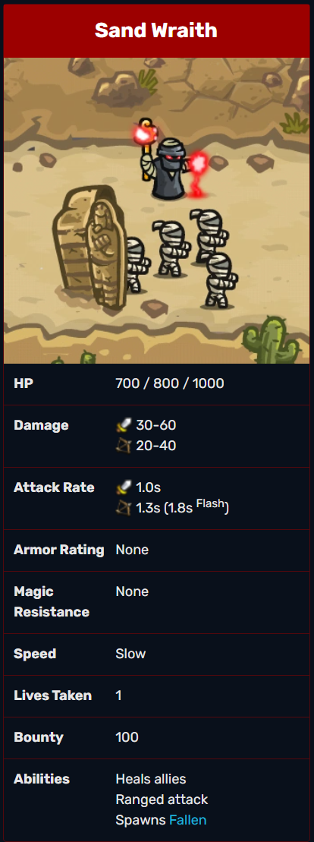
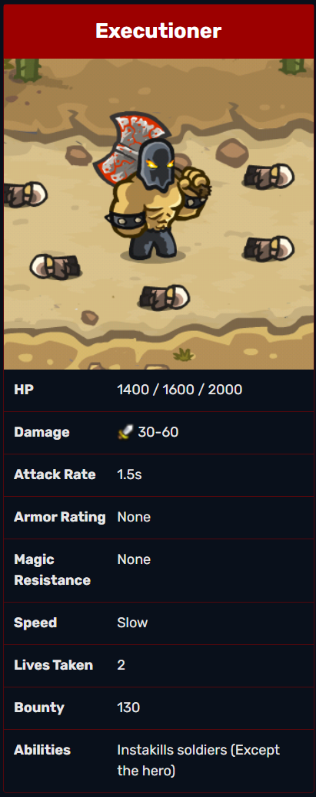
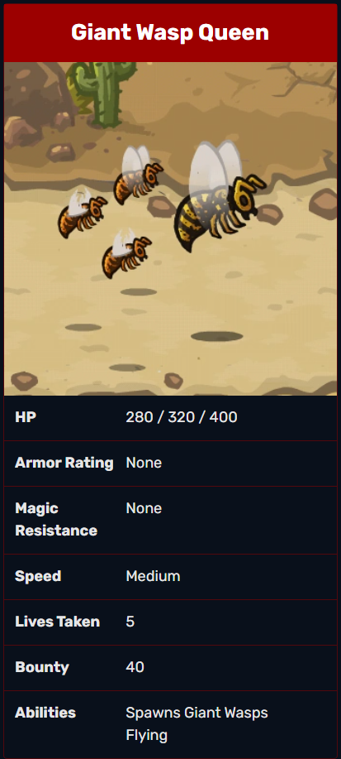

Slide 13
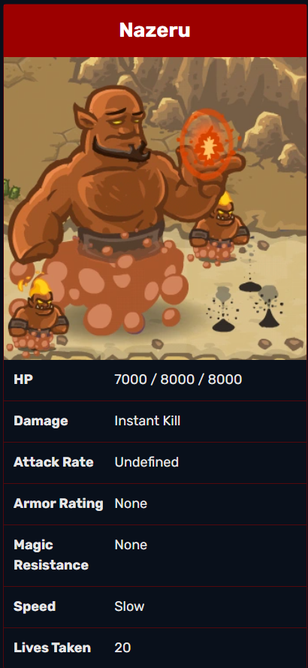
BOSS
Pattern
https://youtu.be/MROhrW8m3N4?t=867

Slide 14
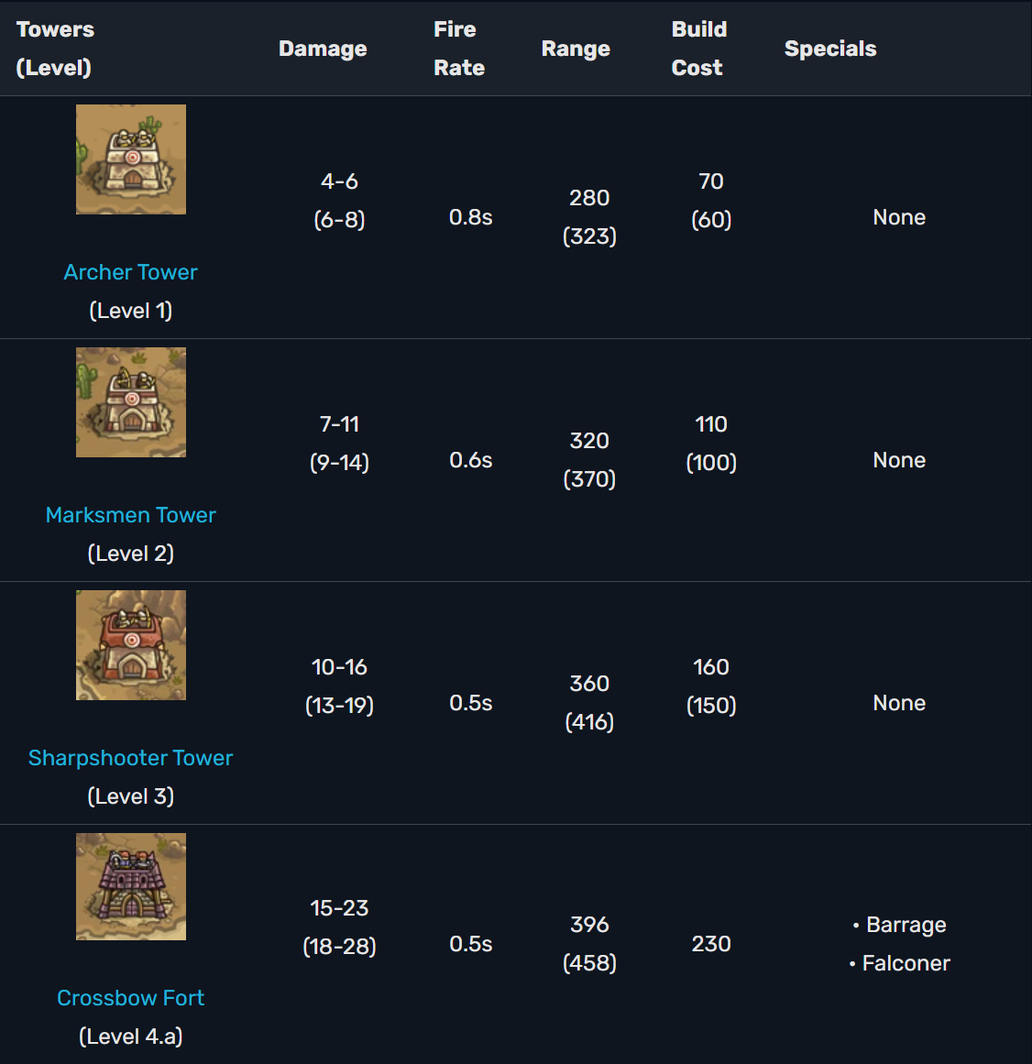

Slide 15
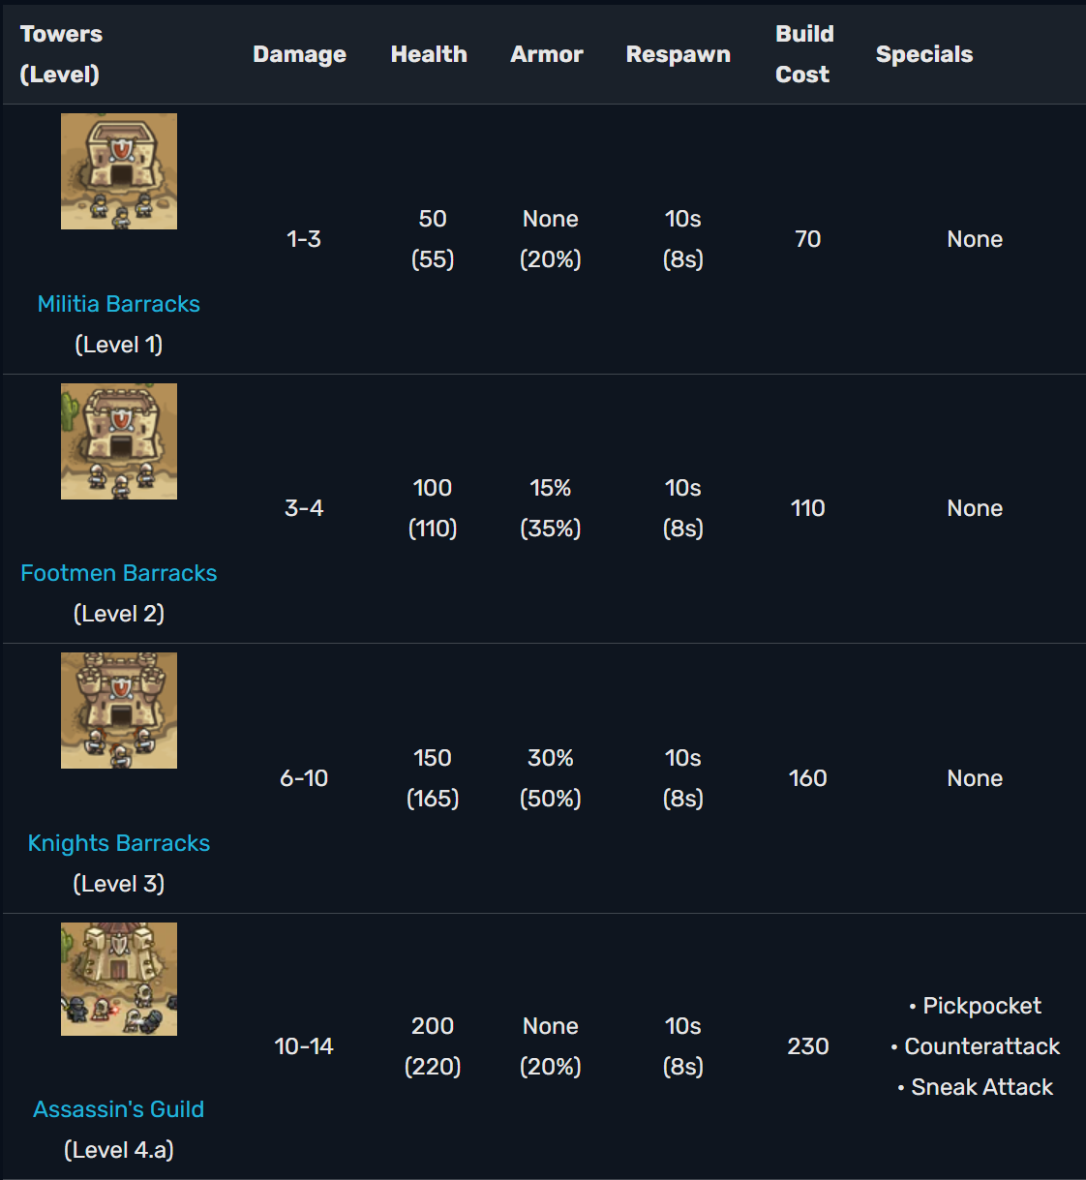

Slide 16
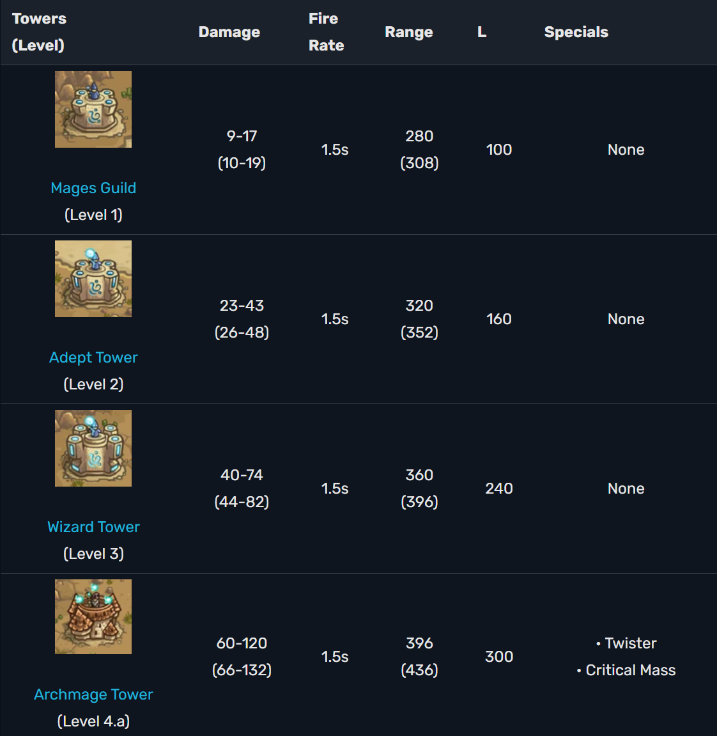

Slide 17
